Slide 1

Lab for Board Validation
David Melanson and Corbin Veitch

Slide 2
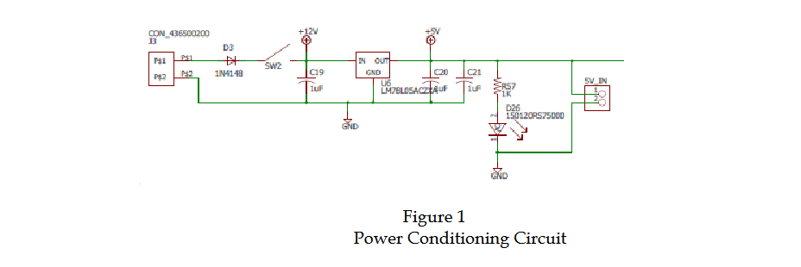
Power conditioning circuit validation was accomplished by inputting voltage at from input side of diode to out output pin of regulator.

Slide 3
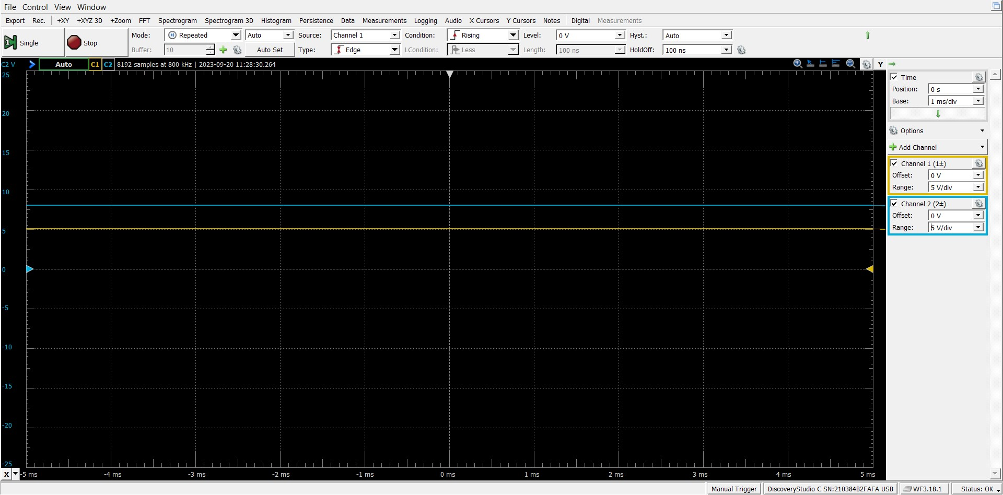

Slide 4
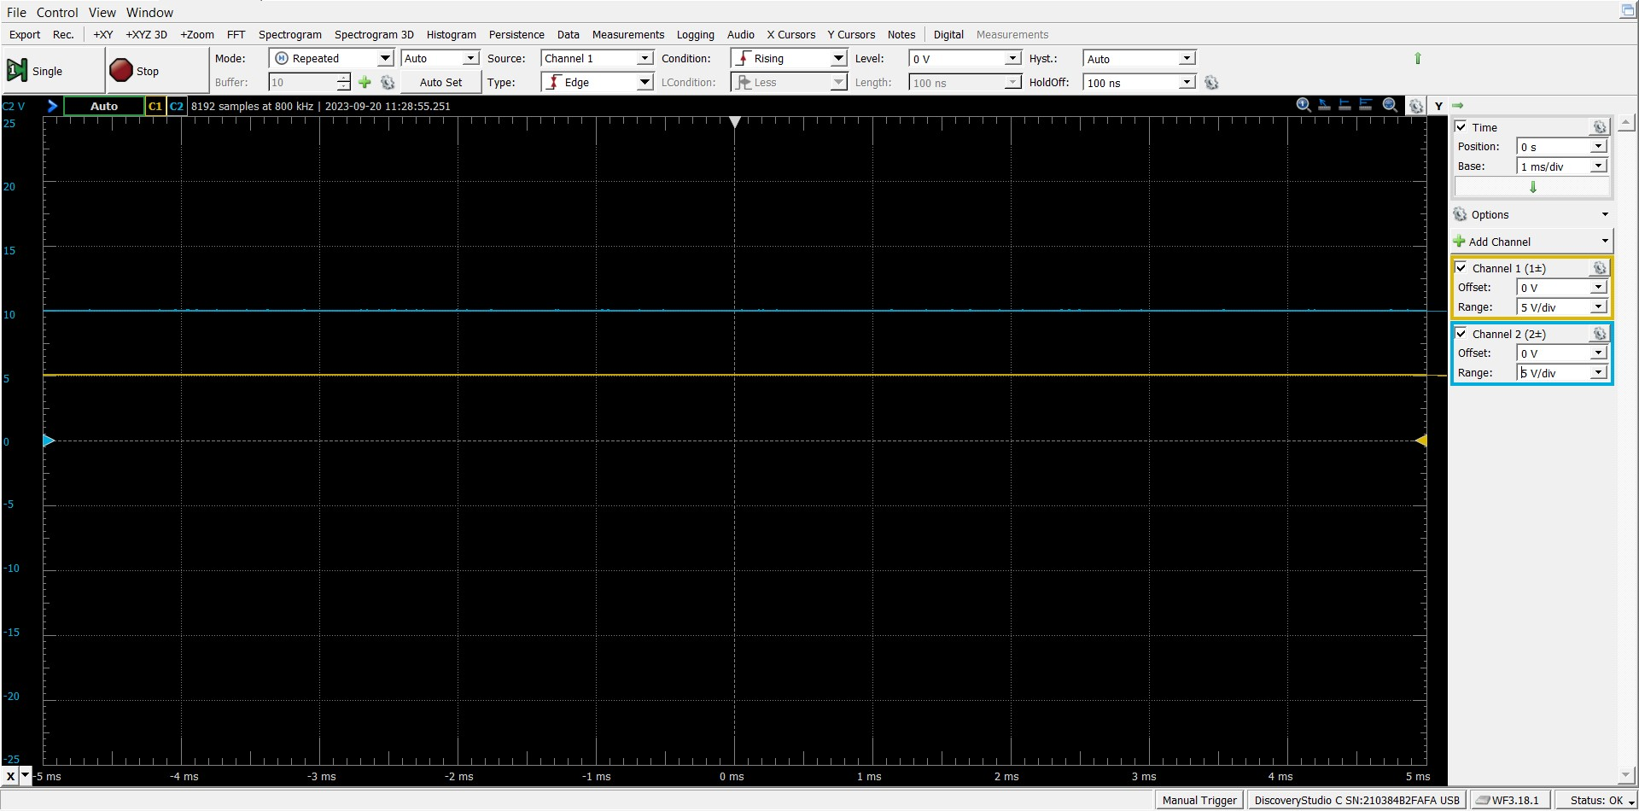

Slide 5
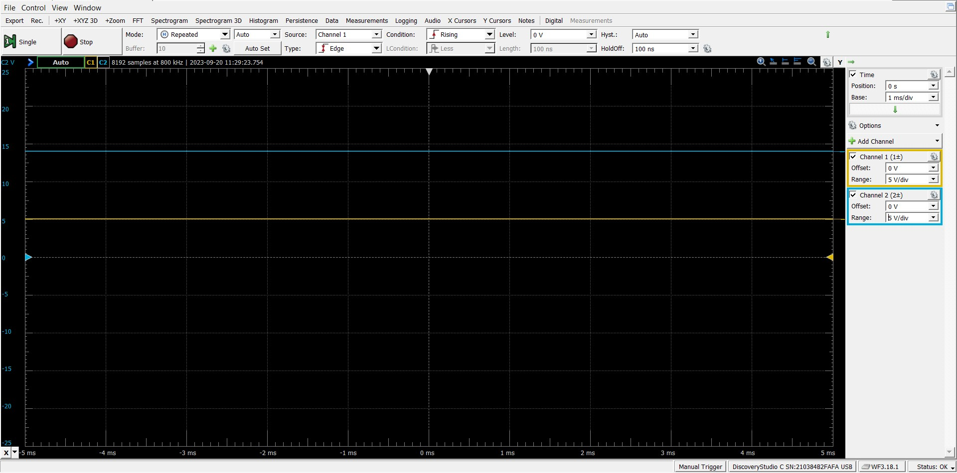

Slide 6


